Slide 1
2024 Governor’s Business Plan Contest
Online-only entry deadline 11:59 p.m. Jan. 31, 2023
Visit govsbizplancontest.com for more information
Questions? Contact Julie Johnson at info@govsbizplancontest.com

Slide 2
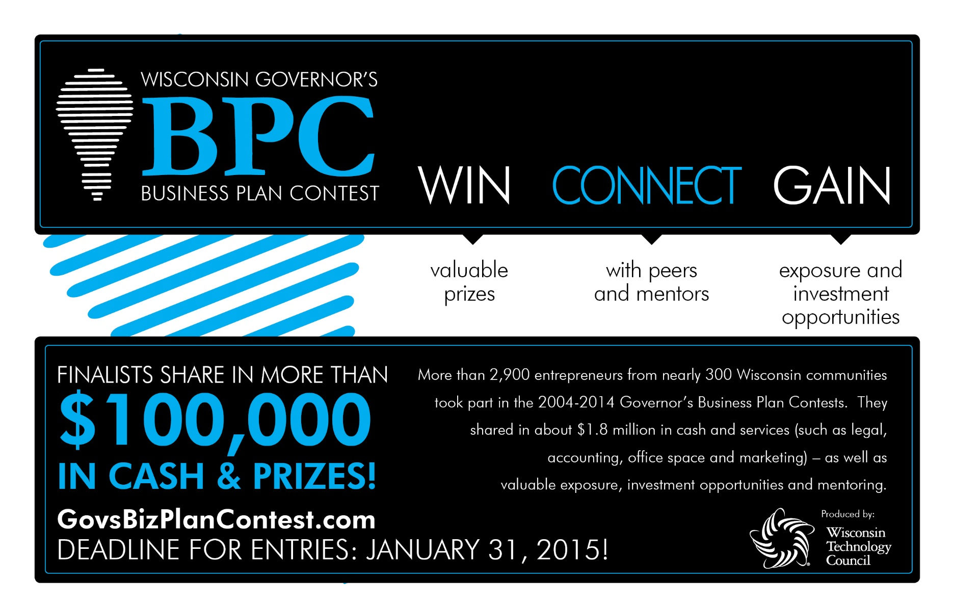
More than 4,660 entrepreneurs from about 346 Wisconsin communities took part in the 2004-2023 Governor’s Business Plan Contests. They shared in about $2.8 million in cash and services – as well as valuable exposure,
investment opportunities and mentoring.
DEADLINE FOR ENTRIES: JANUARY 30, 2019

Slide 3
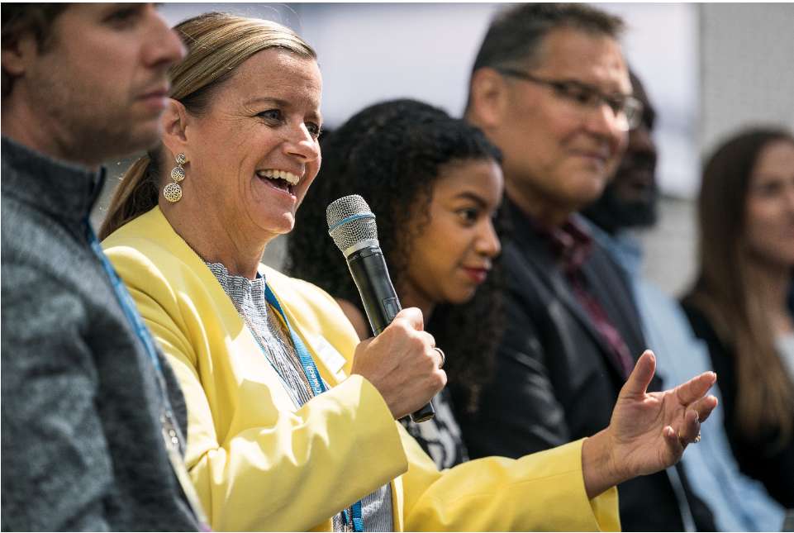
Governor’s Business Plan Contest
A chance to compete for cash and in-kind prizes
Opportunity for entrepreneurs to get constructive feedback on their business plans
A hands-on way to move a plan from “virtual business” to reality
Mission: To encourage entrepreneurs in the startup stage of tech-enabled businesses in Wisconsin.

Slide 4
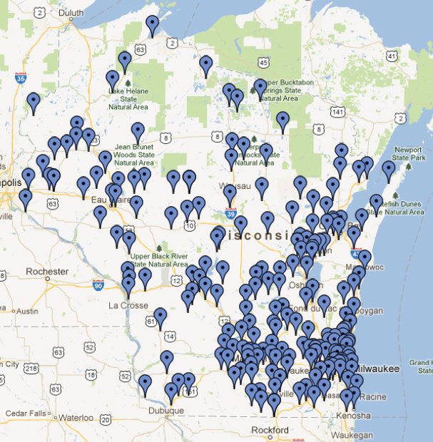
Where did they come from?
2004-2023 Business Plan Contest Participants
BPC by the Numbers:
20 – Years
346 – WI Communities
4,660 – Total Entries
1,010 – Advanced Manufacturing
1,518 – Business Services
1,437– Information Technology
695 – Life Sciences
$300m > – Fundraising
High five-year survival rate

Slide 5
Where are they now?
2004-2023 Business Plan Contest Participants
Vector Surgical (Janet Phillips, 2007): Customers in 50 states, int’l
Atrility Medical (Nick Von Bergen, 2021): Raised $3.4m in 2022 alone
Rapid Radicals (Paige Peters, 2022): Non-dilutive funding of $1.5m so far
RevolutionEHR (Scott Jens, 2007): Used by thousands of optometrists across 50 states; 175 employees and $20m revenue in 2016; spawned two other startups
BioSystem Development (Scott Fulton, 2004): Acquired by Agilent Technologies
MobCraft Beer (Henry Schwartz, 2014): World’s first crowd-sourced beer; one of two BPC winners to appear on “Shark Tank,” has more than 100 retail accounts
POLCO (Nick Mastronardi, 2016): A civic engagement platform used by 1,400 municipalities/local governments nationwide; raised $14m in 2022 alone
Hyde Sportswear (Pat Hughes, 2016): Inflatable life jackets that are comfortable to wear and use. Appeared on “Shark Tank” season 9; more than $1m in sales
Other contest “graduates” include: WiRover, NitricGen, Rowheels, My Health Direct, Platypus, Green 3, Elucent Medical, bluDiagnostics, Scanalytics and scores of others.

Slide 6
TESTIMONiALS
2021 Business Plan Contest Participants
“The Governor’s Business Plan Contest was one of the best programs in which we have participated,” said Karen Renee of Burlington-based eCourt Reporters Inc. “The (company) continues to benefit greatly with our improved business plan and the guidance from many connections through the process. We highly recommend that entrepreneurs in the state of Wisconsin take part for significant growth in a new business!”
“As a woman over 50, I was always curious about how far I could go in the competition,” said Laura Gallagher of Madison-based Mathetria Press. “I became a finalist, in the top three, in the business services category. Whatever stage or age you’re at, I encourage you to show up and do the work. The rewards are there for those who dare!”
“Participating in the Wisconsin Governor's Business Plan Contest was a pivotal point of growth for our company,” said Christian Timm of Fond du Lac’s SmartWell. “It challenged us to think outside the box, honing our ideas into compelling value propositions. The (contest) is an absolute must for every entrepreneur truly serious about growing their business.”

Slide 7
Phase 1: Idea abstracts
Four Categories:
Advanced Manufacturing
Business Services
Information Technology
Life Sciences
Idea abstracts are 250 words and include:
Product or Service Description
Customer Definition
Market Description, Size & Sales Strategy
Competition
About 12 judges are assigned to review each plan

Slide 8
Phase 2: Executive Summary
Top 50 idea abstracts submit a 1,000-word executive summary online:
Company Overview
Product or Service Description
Customer Definition
Market Description, Size & Sales Strategy
Competition
Management Team
Financials
Capital Needs
Mentors – Phase 1, 2 and 3 contestants may submit questions to a group of mentors – innovative business leaders that are volunteering their time and expertise. Email mentors@govsbizplancontest.com.

Slide 9
Phase 3: Business Plans/Pitch decks
The top two dozen executive summaries prepare 15-minute pitch deck with voiceover audio.
Includes same eight criteria as in Phase 2.
Judges will review the pitch decks and select three finalists in each category to advance to the final presentation round.

Slide 10
Final Phase: Diligent Dozen
Live at the Wisconsin Entrepreneurs’ Conference
Top 12 finalists present in front of judges and conference attendees, including investors from around the region.
Presenters receive free admission to the conference.
Live judging, along with the Phase 3 written scores determine the grand prize winner and subsequent place finishers.
Date: Early June 2024

Slide 11
Timeline
Monday, January 31, 11:59 p.m. – Deadline to enter
Thursday, February 2 – Phase 1 judging begins
Thursday, February 15, 8 a.m. – Phase 1 judging ends
Monday, February 19 – Phase 2 opens for semi-finalists
Monday, March 11, 11:59 p.m. – Phase 2 deadline
Thursday, March 14 – Phase 2 judging begins
Thursday, March 28, 8 a.m. – Phase 2 judging ends
Monday, April 1 – Phase 3 opens for finalists
Monday, April 22, 11:59 p.m. – Phase 3 deadline
Thursday, April 25 – Phase 3 judging begins
Wednesday, May 8, 12 p.m. – Phase 3 judging ends
Friday, May 10 – Top 12 selected
Monday, May 15-Friday, May 19 –BPC practice pitches
June 2024 Entrepreneur’s Conference live pitches

Slide 12
Awards
Grand prize winner and all place winners will be awarded during the BPC awards ceremony at the Wisconsin Entrepreneurs’ Conference.
Cash and in-kind prizes totaled more than $119,000 in 2023.
In-kind services include:
Legal
Accounting
Web development
Office space
Prototyping
Marketing
More

Slide 13
FREQUENTLY ASKED Questions
Am I eligible to participate?
Individuals, teams or companies are eligible if they:
Are Wisconsin residents 18 years old or older, and who have a business plan that employs or leverages technology. Examples of technology include an eCommerce platform for a traditional business, a mobile application, a life sciences innovation or an advanced manufacturing process or system.
Are based in Wisconsin and/or plan to locate a business in Wisconsin.
Have not received more than $50,000 in private equity funding as of Jan. 31 for an idea in its current form. For the purposes of this contest, private equity funding is generally angel or venture funding but also includes equity investments by accelerators. It does not include SBIR/STTR, bank loans, non-dilutive accelerator program grants or funding from friends or family. Questions? Email our contest administrator, info@govsbizplancontest.com”

Slide 14
FREQUENTLY ASKED Questions
Can I use Intellectual Property in my business?
All intellectual property used in business ideas and/or plans must be owned or licensed by the BPC entrant. For BPC purposes, examples of intellectual property include but are not limited to trademarks, copyrights, patent-pending status or an issued patent.

Slide 15
FREQUENTLY ASKED Questions
Can I enter more than one idea?
There is no upper limit to the number of unique ideas or plans a contestant may submit. For example, one contestant may submit an idea for a new paper pulping process to the Advanced Manufacturing category and an idea for new paper-making software to the Information Technology category. The same contestant may have more than one idea advance though the competition in one or more categories. Be careful, however: Multiple entries also mean divided time.
Contestants must create a new account for each entry. Each account will require a different email address. If you do not have more than one email address and would like to submit multiple entries, please contact the contest administrator at info@govsbizplancontest.com.

Slide 16
Additional Resources
SCORE is a nonprofit association that helps small businesses get off the ground, grow and achieve their goals through education and mentorship. Supported by the U.S. Small Business Administration and a network of more than 11,000 volunteers, SCORE offers mentoring, counseling, business tools and workshops at a low cost or no charge. www.score.org
The Center for Technology Commercialization provides one-on-one assistance to early stage emerging technology businesses throughout Wisconsin. Center consultants are experts in commercialization processes. They have more than 60 years of combined experience and have collaborated in acquiring more than $100 million in federal and other funding for their clients. www.wisconsinsbir.org
Wisconsin Entrepreneurs’ Toolkit was developed by the Wisconsin Technology Council to provide business startup information and assistance, networking contacts and technical resources. The information caters to individuals interested in starting any type of business including retail, service or technology companies. The Toolkit is available at www.witoolkit.com

Slide 17
Questions?
Julie Johnson
Wisconsin Technology Council
455 Science Drive, Suite 240
Madison, WI 53711
(608) 442-7557
julie@wisconsintechnologycouncil.com

